Slide 1
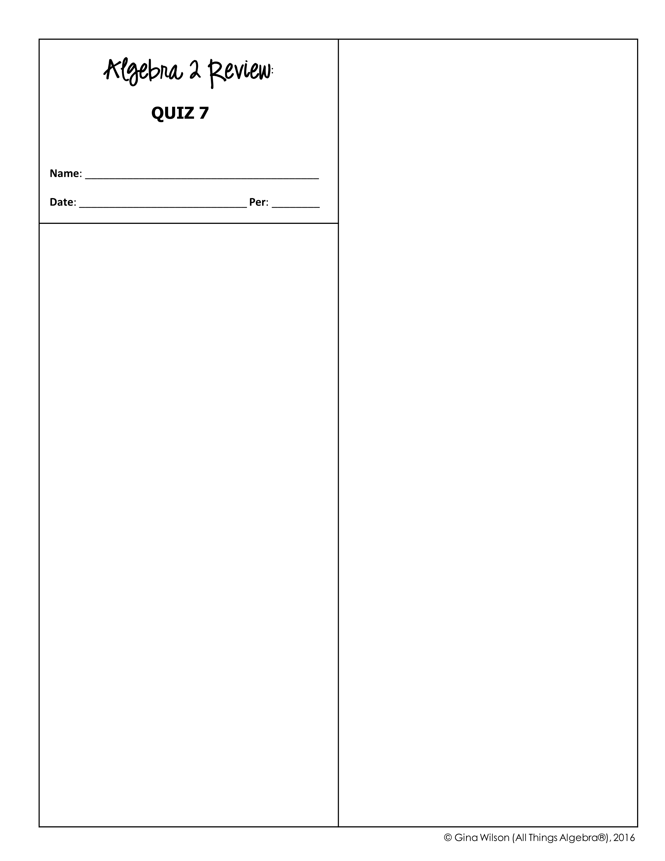
4. What is the 25th term of an arithmetic sequence with a first term of 3 and a common difference of 7?
A. 76 B. 171 C. -158 D. -178
1. Which formula can be used to find the n^{th} term in the sequence below?
5. What is the 9th term of a geometric sequence with a first term of 12 and a common ratio of -3?
A. C. B. D.
A. C. B. D.
2. What is the seventh term of the sequence defined below?
6. Allie used the $1,200 she got from her graduation party to open a savings account. If the account earns 1% interest each month and she makes no additional deposits, how much money will be in the account in 5 years?
(for )
A. C. B. D.
A. $1,312.42 B. $3,112.49 C. $2,180.04 D. $2,158.45
3. Identify the formula for the sequence given below.
7. Evaluate the series:
A. 567 B. 202 C. 825 D. 370
A. C. B. D.

Slide 2

8. What is the sum of the first 20 terms of the series below?
12. Mrs. Hartley gave her students a choice board with 16 projects in which they each had to pick three. How many ways could a student choose three projects?
A. 560 C. 2,304 B. 48 D. 3,360
A. C. B. D.
13. How many different 5-letter passwords can be made using the letters in the word “TRAPEZOID”?
9. What is the sum of the first 8 terms of the series below?
A. 125 C. 12,280 B. 524 D. 15,120
14. The heights of 150 oak trees are normally distributed with a mean of 84 feet and a standard deviation of 3 feet. About how many trees fall within two standard deviations of the mean?
A. 394,540 B. 408,620 C. 479,890 D. 671,846
A. 102 trees C. 143 trees B. 125 trees D. 148 trees
10. Ryan ran 0.5 miles on July 1st. Each day thereafter, he ran 0.3 miles more than the previous day. Find the total number of miles ran in the month of July.
Use for questions 15-16: The wait time of various rides at the amusement park is normally distributed with a mean of 15 minutes and a standard deviation of 4 minutes.
A. 244.9 miles B. 145.5 miles C. 176.2 miles D. 155.0 miles
15. What is the probability that someone will wait for at least 20 minutes?
11. Find the sum of the infinite series below.
A. 89.4% C. 82.1% B. 10.6% D. 17.9%
16. What is the probability that someone will wait between 8 and 18 minutes?
A. No sum C. B. D.
A. 68.1% C. 59.4% B. 73.3% D. 79.5%

